Slide 1
Computer Aided Design CAD
Lecture 1

Slide 2
Agenda
What is CAD
CAD Fields
Graph theory
Types of Graphs
Subgraph and its Types
Network Topology Matrices

Slide 3
What is CAD
Computer-aided design (CAD) is the use of computer systems to assist in the creation, modification, analysis, or optimization of a design.
CAD software is used to increase the productivity of the designer, improve the quality of design, improve communications through documentation, and to create a database for manufacturing.
CAD output is often in the form of electronic files for print, machining, or other manufacturing operations.

Slide 4
CAD Fields
Computer-aided design is used in many fields.
Its use in electronic design is known as Electronic Design Automation (EDA).
In mechanical design is known as Mechanical Design Automation, or MDA.
It is also known as computer-aided drafting which describes the process of creating a technical drawing with the use of computer software.

Slide 5
Graph theory
It is a graphical representation of electric circuits. It is useful for analyzing complex electric circuits by converting them into network graphs.
The graph consists of a set of nodes connected by branches.
Node : is a common point of two or more branches. Sometimes, only a single branch may connect to the node.
Branch : is a line segment that connects two nodes.

Slide 6
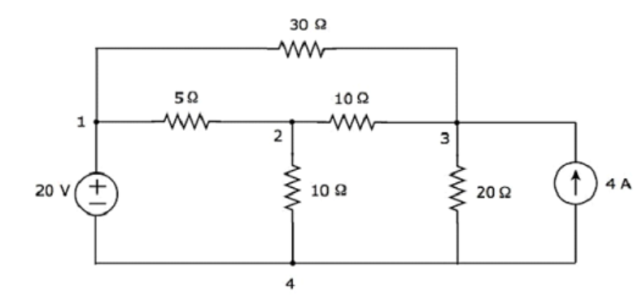
Example
Let us consider the following electric circuit.
There are four principal nodes and those are labelled with 1, 2, 3, and 4.
There are seven branches in the above circuit, among which one branch contains voltage source, another branch contains current source and the remaining five branches contain resistors

Slide 7
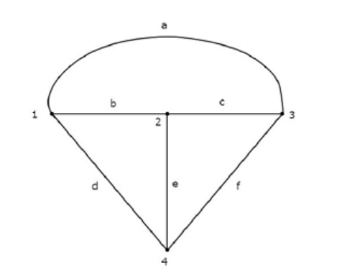
Example Cnt.
Any electric circuit or network can be converted into its equivalent graph by replacing the passive elements and voltage sources with short circuits and the current sources with open circuits.
Equivalent graph

Slide 8
Types of Graphs
Connected and Unconnected graph
Directed and Undirected graph

Slide 9
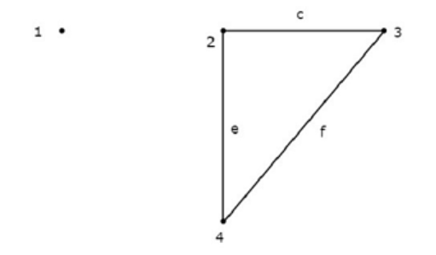
Connected and Unconnected graph
If there exists at least one branch between any of the two nodes of a graph, then it is called as a connected graph (if any two nodes of the graph are connected by a path)
If there exists at least one node in the graph that remains unconnected by even single branch, then it is called as an unconnected graph.
Unconnected graph
Connected graph

Slide 10
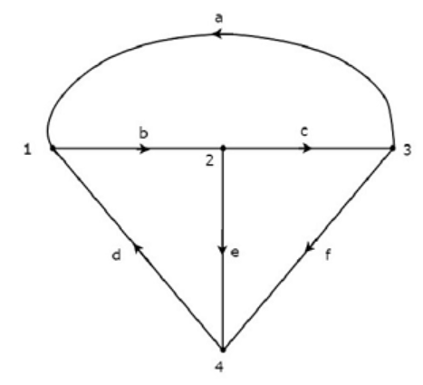
Directed and Undirected graph
If all the branches of a graph are represented with arrows, then that graph is called as a directed graph. Also called as oriented graph.
If the branches of a graph are not represented with arrows, then that graph is called as an undirected graph. Also called as an unoriented graph.
Directed graph
Undirected graph

Slide 11
Subgraph and its Types
A part of the graph is called as a subgraph.
We get subgraphs by removing some nodes and/or branches of a given graph.
There are the two types of subgraphs.
Tree
Co Tree

Slide 12
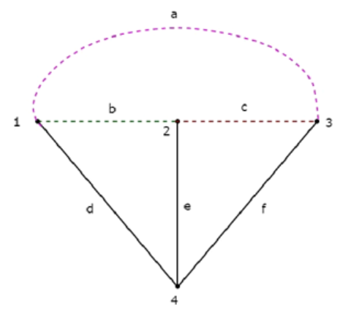
Tree
Tree is a connected subgraph of a given graph, which contains all the nodes of a graph.
The tree must:-
Contains all nodes of the graph
Form a connected subgraph
Does not Contain any loop
Tree Branch: Any branch of the tree
Tree Link : Any branch of the graph not belonging to the tree
Number of tree links = B – (N-1) = B – N + 1
Where N is number of nodes and B is number of branches
Tree

Slide 13
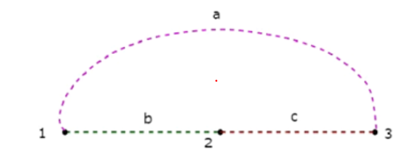
Co-Tree
Co-Tree is a subgraph, which is formed with the branches that are removed while forming a Tree.
Hence, it is called as Complement of a Tree
Co-Tree

Slide 14
Network Topology Matrices
Matrices are important in network problems because
1- They completely describe the interconnections and the reference directions of the branches
2- The two KCL and KVL laws could be easily , compactly and fully expressed by means of matrices that will be explained later
3- They are in a form suitable for sorting in a digital computer

Slide 15
Matrices Associated with Network Graphs
Following are the three matrices that are used in Graph theory.
Incidence Matrix
Fundamental Loop (Tie set) Matrix
Fundamental Cut set Matrix

Slide 16
Incidence Matrix
An Incidence Matrix represents the graph of a given electric circuit or network.
It is possible to draw the graph of that same electric circuit or network from the incidence matrix.
The elements of incidence matrix will be having one of these three values, +1, -1 and 0.
If the branch current is leaving from a selected node, then the value of the element will be +1.
If the branch current is entering towards a selected node, then the value of the element will be -1.
If the branch current neither enters at a selected node nor leaves from a selected node, then the value of element will be 0.

Slide 17
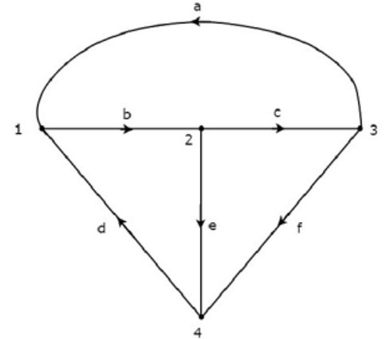
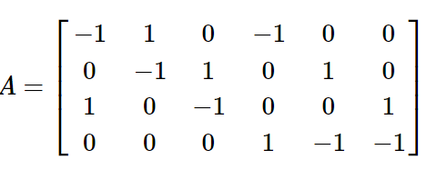
Incidence Matrix Example
Consider the following directed graph.
Incidence Matrix
Graph

Slide 18
Fundamental Loop (Tie-set) Matrix
Fundamental loop or f-loop is a loop, which contains only one link and one or more branches.
the number of f-loops will be equal to the number of links. This matrix gives the relation between branch currents and link currents.
The elements of fundamental loop matrix will be having one of these three values, +1, -1 and 0.
The value of element will be +1 for the link of selected f-loop.
The value of elements will be 0 for the remaining links and branches, which are not part of the selected f-loop.
If the direction of branch current of selected f-loop is same as that of f-loop link current, then the value of element will be +1.
If the direction of branch current of selected f-loop is opposite to that of f-loop link current, then the value of element will be -1.

Slide 19
Tie-set Matrix Example
Consider the following Tree of directed graph

Slide 20
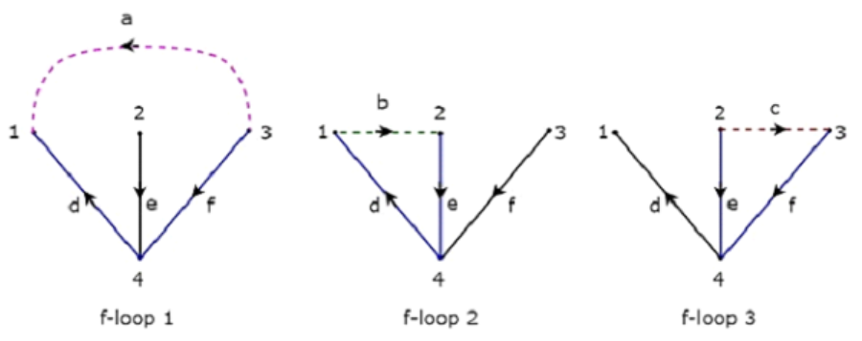
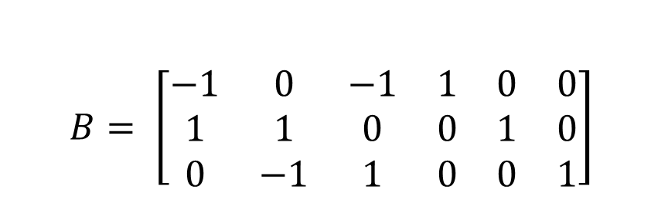
Tie-set Matrix Example Cont.
f-loops
Unit matrix
$$B= \left[\begin{matrix}−1 & 0 & −1 & 1 & 0 & 0 \\ 1 & 1 & 0 & 0 & 1 & 0 \\ 0 & −1 & 1 & 0 & 0 & 1\end{matrix}\right]$$
d | e | f | a | b | c
Tie-set matrix

Slide 21
Fundamental Cut-set Matrix
Fundamental cut set or f-cut set is the minimum number of branches that are removed from a graph in such a way that the original graph will become two isolated subgraphs..
The f-cut set contains only one branch and one or more links. So, the number of f-cut sets will be equal to the number of branches. This matrix gives the relation between branch voltages and twig voltages.
The elements of fundamental cut set matrix will be having one of these three values, +1, -1 and 0.
The value of element will be +1 for the link of selected f-cut set.
The value of elements will be 0 for the remaining branches and links, which are not part of the selected f-cut set.
If the direction of link current of selected f-cut set is same as that of f-cut set branch current, then the value of element will be +1.
If the direction of link current of selected f-cut set is opposite to that of f-cut set twig current, then the value of element will be -1.

Slide 22
Cut-set Matrix Example
Consider the following Tree of directed graph

Slide 23
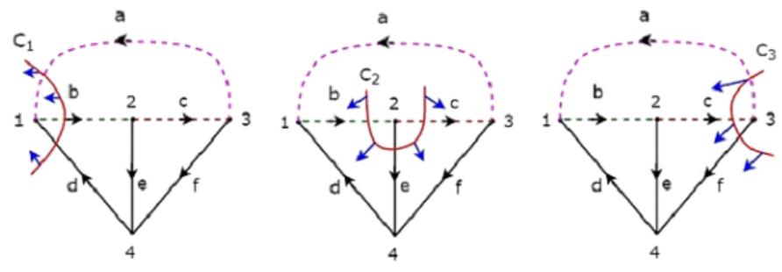

Cut-set Matrix Example Cont.
f-cut sets
Unit matrix
d | e | f | a | b | c
$$C= \left[\begin{matrix}1 & 0 & 0 & 1 & −1 & 0 \\ 0 & 1 & 0 & 0 & −1 & 1 \\ 0 & 0 & 1 & 1 & 0 & −1\end{matrix}\right]$$
Cut-set Matrix

